Slide 1
Microsoft Hybrid Integration Platform Enterprise Integration
Technical data deck
Jon Fancey
Principal Program Manager

Slide 2
Why is integration more important now than ever?
Digital transformation
App is king
Data is everywhere
Everything is connected
Integration is the backbone
Notes:
Businesses are seen as being innovative
IT is seen as catching up to innovation
3 components: proliferation of apps, data as management nightmare, smart devices that need to interact

Slide 3
Integration at the center of digital transformation
c
75%
70%
1/2 the cost
of large organization will establish a hybrid integration platform, by 2020
of the cost of a mobile app project is concerned with integration
of implementing IoT solutions will be spent integrating the various IoT components with each other and the back-end systems, through 2018
Source: Gartner “Market Guide for Hybrid Integration Platform-Enabling Technologies,” by Elizabeth Golluscio, Jess Thompson, Keith Guttridge, April 25, 2016
Notes:
Recent gartner report on hybrid integration platform:
By 2020 75% of organizations will establish a hybrid integration platform
70% of mobile app project is going to be concerned with integration
50% of cost of implementing an IoT solution will be spent on integration

Slide 4


















Straddling two worlds
Challenges for hybrid integration
IT needs
Business Units need
Quickly respond to new requests
Control and stability
Leverage existing systems and tools
Reduce applications, data, business process management nightmare
Adopt newer applications and technologies
Flexibility and agility
Faster time to market
Unlock value from data across both on-premises and cloud

Slide 5








The rise of APIs
IoT
Mobile
“Application programming interfaces (APIs) have been elevated from a development technique to a business model driver and boardroom consideration.
An organization’s core assets can be reused, shared, and monetized through APIs that can extend the reach of existing services or provide new revenue streams.
APIs should be managed like a product - one built on top of a potentially complex technical footprint that includes legacy and third-party systems and data.”
From the “API Economy”
by George Collins and David Sisk
Deloitte Consulting LLP, 2015
Hybrid IT
Cloud
Analytics
Microservices
Notes:
Data and services fuel the APIs. APIs are essential for encapsulation and sharing information. Ever more complex business processes drive API usage inside businesses. Customers demand self-service and friction free interactions and transactions.
“Application programming interfaces (APIs) have been elevated from a development technique to a business model driver and boardroom consideration.
An organization’s core assets can be reused, shared, and monetized through APIs that can extend the reach of existing services or provide new revenue streams.
APIs should be managed like a product - one built on top of a potentially complex technical footprint that includes legacy and third-party systems and data.
From the “API Economy”
by George Collins and David Sisk
Deloitte Consulting LLP, 2015
Mobile and other trends influence API usage across businesses. REST and cloud democratized API – simple and cheap to build and consume.
APIs long transcended high tech companies and are embraced by all verticals including finance, telco, media, and healthcare. For example, established banks are exploring becoming banking platforms to compete with PayPal, Stripe, Venmo, etc. Every auto maker is busily working on a telematics platform for their cars. Governments at every level adopt open API initiatives and make data and services available, e.g. 311, crime, etc.
Agility and innovation are ever more important due to increased competition and disruption. Loosely coupled APIs are the technical foundation – microservices.
All traditional enterprise integration vendors are pursuing API-centric approach which pivots around exposing data internally and externally rather than connecting application together.

Slide 6
Nearly 40% Of US Enterprises Will Adopt API Management Solutions By 2020
The US API management market will grow more than fourfold from $140 million in 2014 to $660 million by 2020.
Forrester: Sizing The Market For API Management Solutions 2015

Slide 7


Enable digital transformation using an API led economy
Experience APIs
Microsoft Integration
Process APIs
Microsoft Integration
Service APIs
Microsoft Integration
End user
Web
Mobile
IoT
IT admin

Slide 8
Microsoft Integration Platform

Slide 9

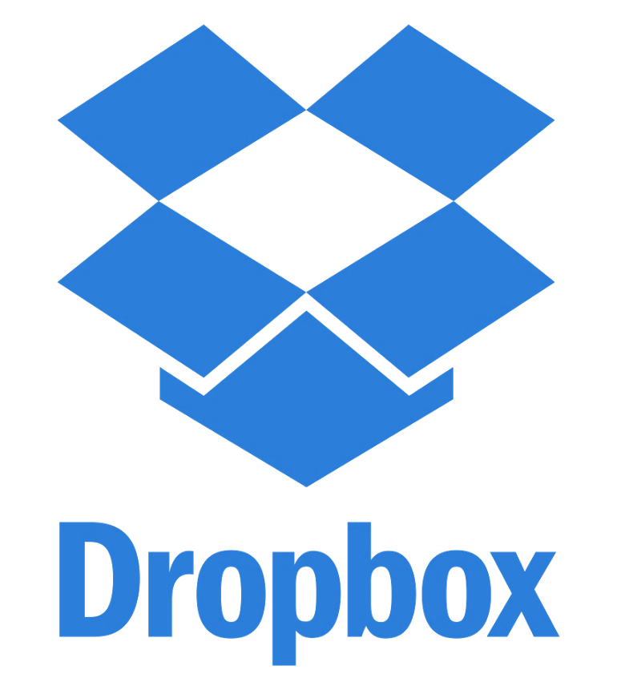




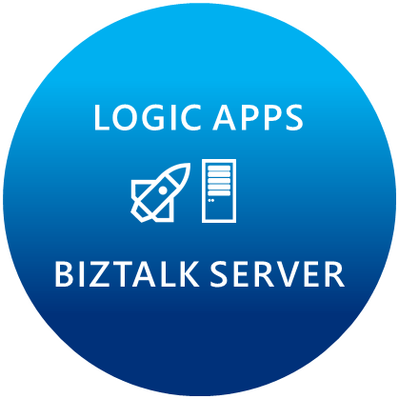
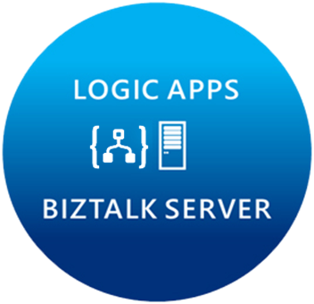












Microsoft’s Hybrid Integration Platform
LOGIC APPS
BIZTALK SERVER
About 39% of developers are focused on building cloud based Application integration
API MANAGEMENT
AZURE SERVICE BUS
IoT/Event Hub
Azure Search
SQL Database
CONNECTORS
AZURE SERVICES
AZURE SERVICE BUS
DocDB
BLOB Storage
Functions
API MANAGMENT
Machine Learning
HD Insight
Site Recovery
B2B/EDI
Tables
Cognitive Services
DNS
Notes:
Its not just about the products, we have a pool of out-of-the-box connectors that help connect to many SaaS applications.
Secret sauce is really the Azure services.
Azure is now at your fingertips – opens doors to numerous possibilities.
Traditional integration vendors, ask customers to build silo-ed integration solutions.
That approach is not going to allow you to scale to your customer needs.
With Azure, you can build holistic solutions.
I can do more than integration – once you have your connected system, you can perform analytics on the data using HD insight, machine learning, to gain insight on your data.
This is going to help customers make great business decisions.
Some of you have IoT practices today, this is how you can leverage integration and IoT together.
At MSFT, we think that there are multiple points of entry into integration: Think about your customers who reach out to you about mobile development, about IoT solutions, any e-commerce applications, eventually they are going to need a solid integration platform – and that’s what MSFT offers.
2 key differentiating factors to highlight again:
Hybrid 2. Azure Services

Slide 10
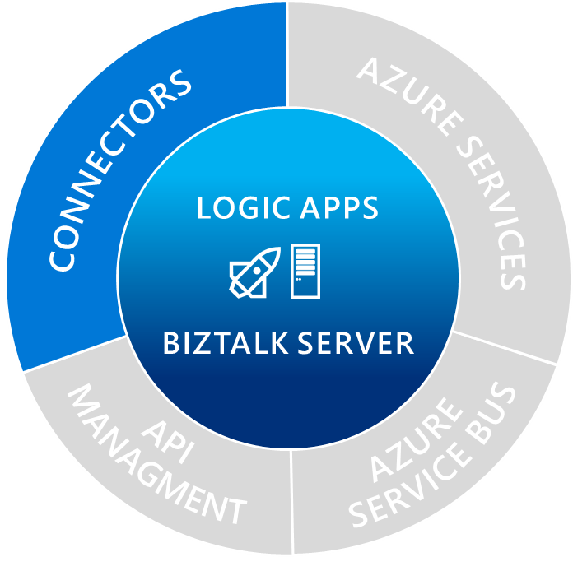
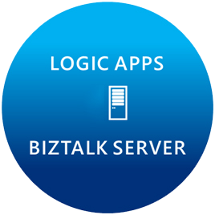

Managed connectors
Cloud APIs and platform functionality
Dozens of built-in connectors
Hosted and managed within the platform
Scales to meet your needs
First class designer experience
Rapid development
API connections
Authenticate once and reuse
Differentiate connection configuration
Simple to deploy
Portal experience for managing API Connections

Slide 11
Spectrum of connectors
SaaS
Protocols/Native
appFigures
Asana
Azure API Management
Azure App Services
Azure Automation
Azure Cognitive Face API
Azure Cognitive LUIS
Azure Cognitive Text Analytics
Azure Data Lake Store
Azure Document DB
Azure Functions
Azure Machine Learning
Azure Resource Manager
Azure Service Bus
Azure SQL
Azure Storage Blob
Azure Storage Queues
Basecamp
Bing Search
BitBucket
Bitly
Blogger
Box
Buffer
Campfire
Chatter
Common Data Service
Disqus
DocuSign
Dropbox
Dynamics AX Online
Dynamics CRM Online
Dynamics CRM Service Bus
Dynamics Financials
Dynamics Operations
Easy Redmine
Eventbrite
Facebook
Freshdesk
GitHub
Gmail
Google Calendar
Google Contacts
Google Drive
Google Sheets
Google Tasks
GoTo Meeting
GoTo Training
GoTo Webinar
Harvest
HelloSign
Infusionsoft
JIRA
Insightly
Instagram
Instapaper
MailChimp
Mandrill
Medium
Microsoft Project Online
Microsoft Translator
MSN Weather
Office 365
Office 365 Users
Office 365 Video
OneDrive
OneDrive for Business
OneNote
Outlook.com
Outlook Tasks
PagerDuty
Pinterest
Pipedrive
Power BI
Project Online
Redmine
Salesforce
Salesforce Chatter
SendGrid
SharePoint Online
Slack
SmartSheet
SparkPost
Stripe
Survey Monkey
Todoist
Trello
Twilio
Twitter
Typeform
UserVoice
VS Team Services
Wordpress
Wunderlist
Yammer
YouTube
HTTP, HTTPS
HTTP Webhook
FTP, SFTP
SMTP
RSS
Compose, Query, Parse JSON
Wait
Terminate
Workflow
XML & EDI
XML Validation
Transform XML (+Mapper)
Flat File Encode
Flat File Decode
X12
EDIFACT
AS2
Integration Account Artifact Lookup
Hybrid
BizTalk Server
File System
IBM DB2
Informix
SharePoint Server
SQL Server
SAP
Websphere MQ
Notes:
Call out that we now support stored procs on-prem

Slide 12


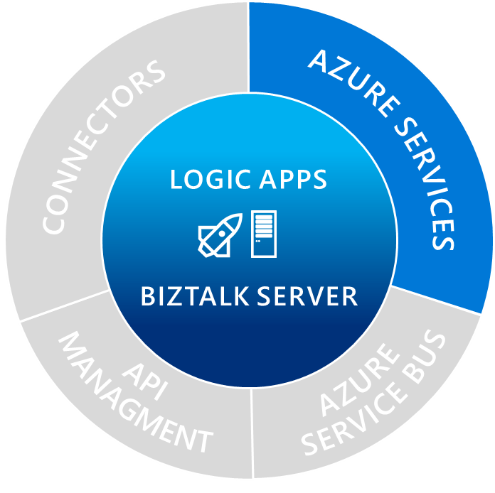




Breadth of Azure services
SQL Database
Azure Machine Learning
API Management
Functions
Site Recovery
DocDB
Azure Service Bus
Azure Search
IoT/Event Hub
Cognitive Services
BLOB Storage
CONNECTORS
AZURE SERVICES
AZURE SERVICE BUS
LOGIC APPS
Functions:
Make composing cloud apps easy
Easily integrate with Logic Apps
BIZTALK
Cognitive
Services:
Sentiment analytics
Language and topic detection
API MANAGMENT
B2B/EDI
Machine
Learning:
Intelligence and proactive management
Analytics that enable action
Notes:
Lets say you want ot run a small piece of code and resuse the results in Logic Apps – use functions
Customer example for cognitive services

Slide 13

True on-premises and cloud connectivity
Microsoft Flow
BizTalk Server
Integrate on-premises LOB to SaaS apps Automate mission critical processes Support for latest Microsoft Platforms
Logic Apps
Serverless compute, auto scaling, fully managed Connect SaaS applications Leverage Azure Services
API Management
Document and catalog LOB APIs Discover, manage and secure connectivity Gain insights, measure and monetize
Service Bus
Serverless compute, auto scaling, fully managed Publish & Subscribe, Topics and Queues Secure and predictable message delivery
Microsoft Pro Integration Team
Notes:
Quick overview of products:
Need governance of APIs across on-premises and cloud applications.
The evolution of hybrid integration platform (HIP) approaches creates requirements and opportunities for converging application and data integration. Characteristics of HIP-enabling technologies include interdisciplinary integration patterns, cloud/hybrid enablement, and diversity of user personas (spanning integration specialists to citizen integrators). This technology evolution will drive inherent synergies between data and application integration as a unified and pervasive set of disciplines (see "Modernizing Integration Strategies and Infrastructure Primer for 2016" ).

Slide 14

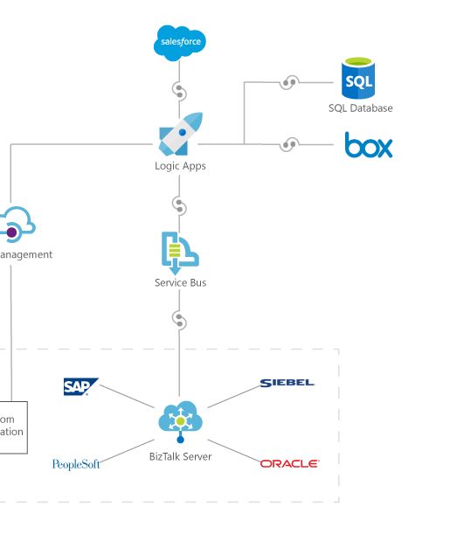









Orchestrate anything
Azure SQL
Microsoft
Dynamics CRM
Connect on-premises, hybrid and cloud applications
Run mission-critical, complex integration scenarios with ease
Enhance business productivity by automating business processes
Easily connect custom on-premises applications to the cloud
Coming Soon
SAP and FILE
Logic Apps
API app
On premises data gateway
Web app
SAP
FILE
SQL Server
BizTalk Server

Slide 15
Azure API Management

Slide 16

Azure API Management
API consumers
AZURE API MANAGEMENT
Abstraction
decouple
modernize
optimize
...
Middleware
secure
protect
cache
...
Monitoring
usage
health
monetization
...
Developer
discover
document
on-board
...
APIs on Azure
Azure APIs
On-prem APIs
3rd party APIs
Notes:
There is a saying that any problem in software engineering can be solved by adding a level of indirection (or abstraction). Abstraction has its costs to be sure, but benefits usually are much greater. APIM creates a public facade over your APIs and decouples API implementations or backends from API consumers enabling them to evolve independently. This includes hiding all APIs regardless of their location behind a single domain name and API address. Exposing only a subset of backend capabilities to API consumers. Modernizing and normalizing APIs by changing their URL structure and response formats. Optimizing APIs for specific consumers and scenarios by conditionally stripping down the responses. Dynamically routing requests to implement advanced versioning approaches
Second, APIM allows API implementers to externalize and centralize common cross cutting concerns and focus on the core value, the domain related logic. Security, throttling, cross domain access and response caching are just a few horizontal capabilities you'll get from APIM. APIM supports API key, JWT token validation as well as IP based authorization. We offer a number of cross domain techniques including full support for CORS. APIM implements distributed quota and rate limiting policies that allow a great degree of flexibility and scale. It comes with built in response cache and policies that allow fine grained control over what and how gets cached
Having insight into usage and health of your APIs is important and APIM captures metrics and provides key reports out of the box. For those customers who are looking to monetize their APIs we collect and offer via API data allowing them to implement a variety of subscription business models.
With APIM Developer portal you can treat internal and external developers the same way from the get go and provide them with a self service on-boarding experience, AP catalog, documentation, samples, and allow them to send request to your APIs without writing a line of code.
■ Know who API users are and engage them like customers. Whether the developers programming to one’s APIs are inside the organization or outside, knowing who they are is a foundation of API success. For an API provider that charges for API use, like Twilio and SendGrid, this is of course necessary for collecting revenue, but even for free access, as with New York’s and Chicago’s transit systems’ APIs, knowing API users enables greater understanding of how APIs are used and what direction to take APIs in the future. API users, whether they pay or not, should be engaged as customers.
■ Clarify the rules of API access. For reasons of capacity management and security, access to APIs is rarely unlimited. But customers (i.e., API users in this case) don’t like surprises, so the
rules for access must be clear, such as what data may be accessed and how many requests are allowed per minute or per month. is may include de nition of di erent access plans with di erent rules for di erent API users.
Make it easy to use the API. rough documentation, examples, and discussion forums, it must be easy for API users to understand the API, get answers to questions, test API usage, and migrate between API versions. Although REST services are needed for mobile, other styles of services may also be part of an enterprise API strategy (e.g., SOAP, message queuing).
Enforce the rules of API access. API providers must validate that incoming API requests are authorized and comply with the rules de ned by the access plan each API user is associated with.
Proactively manage API success by treating it as a product. Whether API users are internal, external, or both, to optimize the business value of an API, the API provider must treat it as a product with customers and a life cycle. Whether via basic reporting or advanced analytics, API providers must understand patterns of API access, including error rates that may indicate the
API is di cult to understand. New versions of the API need a smooth and managed rollout to API users.
■ Connect API access to functions and data within their technology estate. APIs deliver their value by connecting to the API provider’s data and applications. Some of these assets may be API- ready, while others may need some manner of integration connectivity to make them accessible.

Slide 17



AZURE API
MANAGEMENT
APP DEVELOPERS
Developer Portal
DIRECT OR
VPN
BACKEND
APIs
APPS
Gateway
Hosted anywhere.
Developed using any technology.
API PUBLISHERS
Publisher portal
Notes:
API management solution components.
APIM on Azure is provided as a fully managed cloud service. It has 3 key components.
Publisher portal is used by API publishers, people who own the APIs, to manage the APIs. On the Publisher portal one can add and edit APIs, configure API policies, view analytics, etc. Metadata and settings entered on the Publisher portal drive both the gateway and the developer portal. Management operations can be automated by using a comprehensive but easy to learn and use API.
Developer portal is turn key and shows auto-generated API catalog, interactive documentation and samples. Its look-and-feel and behavior can be customized to reflect customer brand and needs.
Gateway acts as a front door and mediates all the requests to your APIs, collecting usage and health data and applying policies configured via Publisher portal. It can connect to backends located anywhere and implemented and running on any technology stack either directly or via VPN. Gateway supports both Basic HTTP and mutual certificate authentication.

Slide 18




The API-enabled network

Slide 19
Azure Logic Apps

Slide 20
Azure Logic Apps
Create business processes and workflows visually
Integrate with SaaS and enterprise applications
Unlock value across on-premises and cloud
Automate EAI, B2B/EDI, and business processes
Leverage Integration Platform as a Service (iPaaS)
Transform workflows into intelligent actions
Notes:
Create business processes and workflows visually
Use simple intuitive tools that allow you to rapidly create workflows bringing value to the business faster.
Utilize dozens of pre-built templates that help you get started, help you understand patterns, or inspire you to see new ways to integrate services.
Integrate with SaaS and Enterprise applications
Access the data that you need for your business processes in the place that they live. That data can live in a cloud data store like dropbox, onedrive or in an enterprise management system like Salesforce or Dynamics.
Better together allows you to use Azure services.
Unlock value across on-premises and cloud
Logic Apps allows you to each into your on-premises Line of Business systems through the newly released on-premises data gateway.
Also allows for utilizing BizTalk Server through the BizTalk connector
Automate EAI, B2B/EDI and business processes
With the Enterprise integration pack we have provided the capability to manage your messaging collateral, manage trading partners and agreements
Leverage integration platform as a service (iPaaS)
Remove the worry of hosting

Slide 21
Message Handling
Flexibility in content types
Flexible content, binary, JSON, XML, primitives
Schema support for JSON schema and XSD
Mapping
XSLT-based – use existing assets
Visual Studio mapper to create xslt-based maps
Parameters support*
Validation
Check for errors in selected schema
Flatfile
Convert to/from flatfile – csv, delimited, positional
Built-in type conversion json<>xml<>base64
Flexible processing
Decoupled messaging from processing
Ability to send data to a batch*
Release on specific criteria e.g. size/time
Group by user-defined data (partitioning)
Or use Flush action to release batch immediately
EDI
Outbound encoders, X12, EDIFACT will make use of batching for B2B
Out of box X12 and EDIFACT schema
Leverage batching capabilities

Slide 22
Enterprise messaging
Validate
Extract
Transform
Enrich
Route
XML Validation
@xpath
XSL Transform
Compose
Send message to topic
VETER Pipeline
Reference schema in Integration Account
Select literals, single nodes or node-sets
BizTalk mapper compatibility
Parameter support (enrich)
Construct a new message

Slide 23
Integration Account
Schemas
Maps
Trading Partners
Agreements
Certificates (KeyVault integration)
Extensible
Store your own configuration
Easy to manage
REST API, PowerShell, Portal, Visual Studio
Secure, scalable, manageable
Schemas
Maps
TPM
Custom
Config

Slide 24
Debugging and History
Trigger history
Run history
Monitoring view
Diagnostics & Alerts
Azure

Slide 25
Logic Apps Tracking
Event monitoring
Azure Monitoring today
Emit core tracking events
Send to storage or event hub
Use TrackedProperties for your own tracking data
B2B
Operations Management Suite solution
Configured from Integration Account
Tracking API

Slide 26
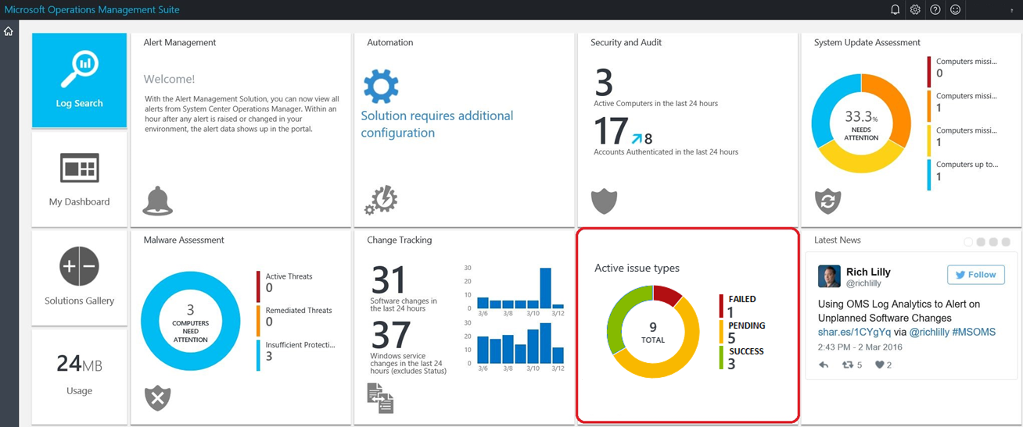
Tracking Experience

Slide 27
BizTalk Server 2016

Slide 28
Microsoft BizTalk Server
Connect any on-premises application
Extend connectivity to the cloud
Go beyond siloed integration
Automate mission critical business processes
B2B/EDI workflows
Message brokering
Business activity monitoring
Connect to cloud applications using Azure Logic Apps Adapter
Adopt cloud on your own pace
Gain insights on your data using Microsoft cloud
Get first class integration with Azure services through the Azure Logic Apps Adapter

Slide 29
Why BizTalk Server 2016?
Support for newer first party platforms
Windows Server 2016
SQL Server 2016
Visual Studio 2015
Office 2016
SQL Server 2016 AlwaysOn availability groups
BizTalk Server Azure VMs in production
New Azure Logic Apps Adapter

Slide 30




Hybrid Connectivity
SalesForce
SalesForce
Update Trigger
Create in SalesForce
Update
Reply with cust ID
Logic App
Logic App
Yammer
Logic App
Logic App
Yammer
Cloud
On-prem
Order Processing
Orders
Orders
Store order
BizTalk Server 2016
BizTalk Server 2016
Update Customer
Order
Order
Receive a new order
Customers
Customers
Look up customer
Create Customer
Update Customer

Slide 31
Azure Service Bus

Slide 32
Azure Service Bus
Publish and subscribe to messages with Topics
Asynchronous messaging over Queues
Read message patterns:
Auto-complete
Peek-lock and complete/abandon
Immediate triggering
High throughput

Slide 33

The basics of a queue
Sender sends message to queue
Queue ACKs receipt
Receiver connects to queue & retrieves message
Receiver ACKs complete (or other action)
Sender
Receiver

Slide 34
Topics & Subscriptions
Sender only knows about Topic
Receivers only know about Subscriptions
Filters and Actions exist on Subscriptions
Subscription 1
“type” = “order”
Topic
“type” = “quote”
Subscription 2

Slide 35

Relay: Real-time communication proxy
The basis of Hybrid Cloud
Used to decouple
Location
Security
VPN and Firewall constraints
Client
Service

Slide 36
Resources
BizTalk Dev Center https://msdn.microsoft.com/biztalk
Try Logic Apps on http://aka.ms/logicapps-try
Send us your ideas on http://aka.ms/logicapps-wish
Keep up with capabilities on http://aka.ms/logicapps-docs
Get answers
http://aka.ms/logicappsblog, http://aka.ms/biztalkblog
Watch us on http://aka.ms/logicappslive
Sign-up for news, mail to: biztalkintegration@microsoft.com
Follow us on @logicappsio, @biztalk_server

Slide 37




Customers using Microsoft Integration
Mission Linen Supply
Today, with our Azure Logic Apps solution, we can get suppliers onboarded within two weeks versus the two months or longer that the EDI [Electronic Data Interchange] provider required.
Fantasy Data
This platform definitely opens the door for a lot of people to build their own sports applications for websites and mobile devices. We’ve succeeded in creating an open API that empowers people to be as creative as they want.
Macaw Business Solution
“BizTalk Server 2016 makes your enterprise communicate with any application, data and business process anywhere. It offers bigger, better, more capabilities, features and connectivity options.”

Slide 38
Thankyou

